Slide 1
E-Commerce
Customer Churn
Present by Chhorvy
Python Project
Start Now

Slide 2



Table Of Contents
1. Introduction
2. Data Preparation
3. Feature Engineering
4. Exploratory Data Analysis
5. Model Building
6. Model Evaluation

Slide 3

1. Introduction
E-commerce has provided many new opportunities to consumers, and it is still opening new ones. The rapid expansion of IT technologies and the Internet has resulted in this sector’s rapid growth. In the eCommerce market Cambodia, the number of users is expected to amount to 7.8m users by 2025.
Problem statement: The success of companies hugely depends on how well they can analyze the data on their clients' behavior. Customers' churn may be considered as a lost opportunity for profit. The costs of gaining new customers are usually five to even six times higher than the costs of retaining an existing customer.
References: https://www.statista.com/outlook/dmo/ecommerce/Cambodia,
https://www.researchgate.net/publication/352946623

Slide 4


Project Goal
Build a reliable model to predict the customer churn rate
Know potential churners
Take Action to preserve customer

Slide 5
2.Data Preparation
Import libraries:
Inspecting data:
Numpy
Pandas
Matplotlib
Seaborn….
Cleaning data
Shape:( 5630,21)
There are 6 columns which missing value 4-5%
No duplicate values
Drop not important feature: ‘Customer ID’
Fill missing value with median
Outlier Treatment

Slide 6
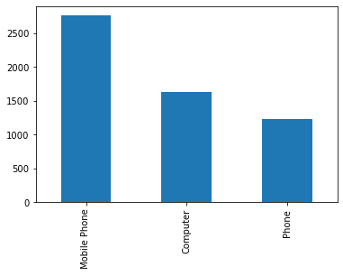
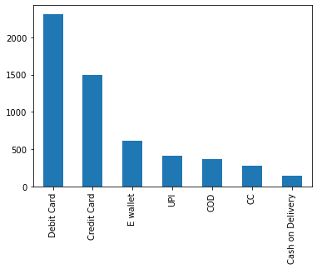
Data in visualization format
How each category performed in each columns?. To visualize the data a bit more, one can combine all the categorical variables. Look below for a better understanding:
Preferred Device
Payment Types

Slide 7
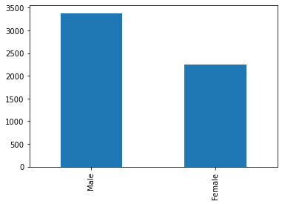
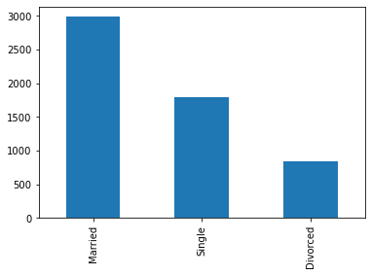
Customer Gender
Married Status

Slide 8
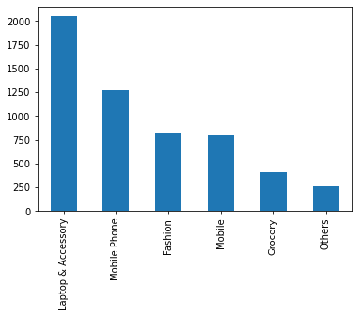
Product Category

Slide 9
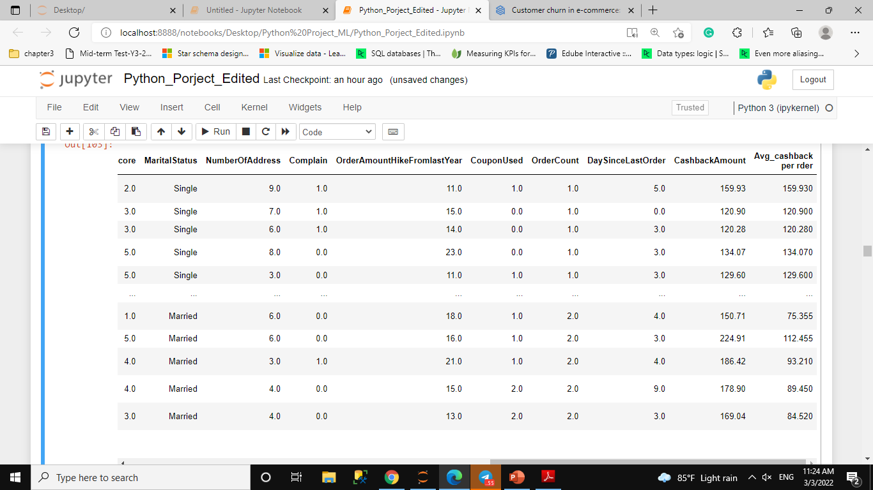
3. Feature Engineering
Add new feature called 'Average Cashback per order’ .Cashback is the Average cashback in last month.
The calculation: Average cashback per order
[CashbackAmount ]/ [OrderCount]
Target feature :’Churn’
All other columns become feature variables

Slide 11
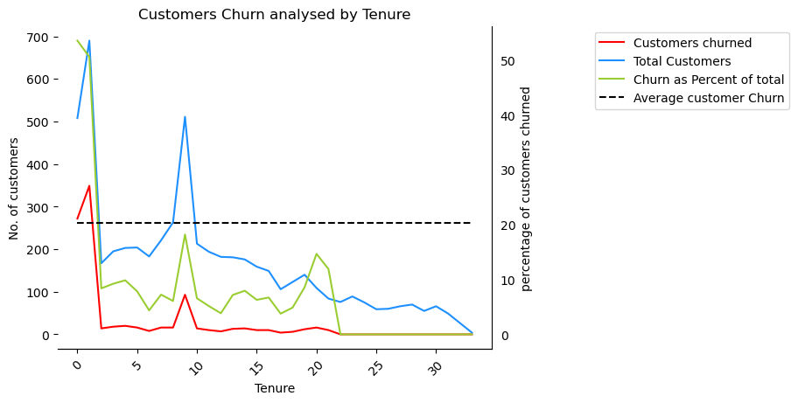
4. Exploratory Data Analysis
EDA - Univariate Analysis - Analysis Churn by each Variable
How customer behave ?
Churn by Tenure
Customer who have been with company around 0-2 months churned the most and likely to churn. Churn_percentag of 0 months= 53.54%.
Customer who stayed more then 22 months are less likely to churn. Churn_percentag 22 up months= 0%.
months

Slide 12
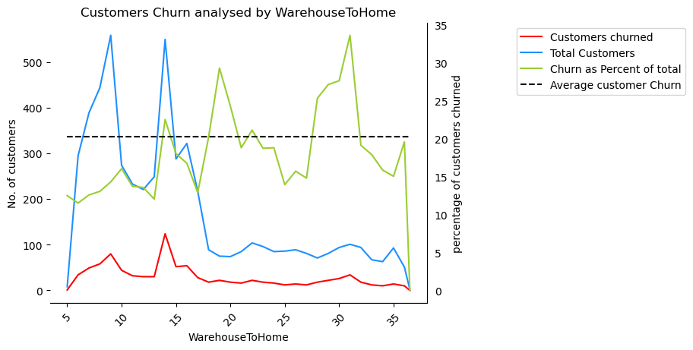
Churn by Warehouse To Home
Most of customers are near warehouse 5km -18km.
Customer who far more than 20 km is likely to churn.
Km

Slide 13
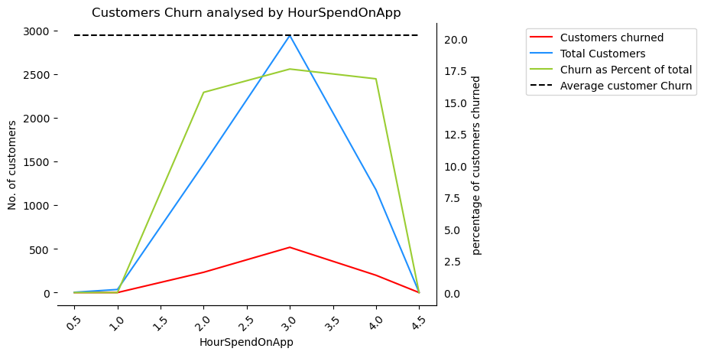
Churn by Hour Spend On App
Mostly customer spend on web around 2.5-3.0 hours, but 2-4 also most likely to churn which is 15-17%.

Slide 14
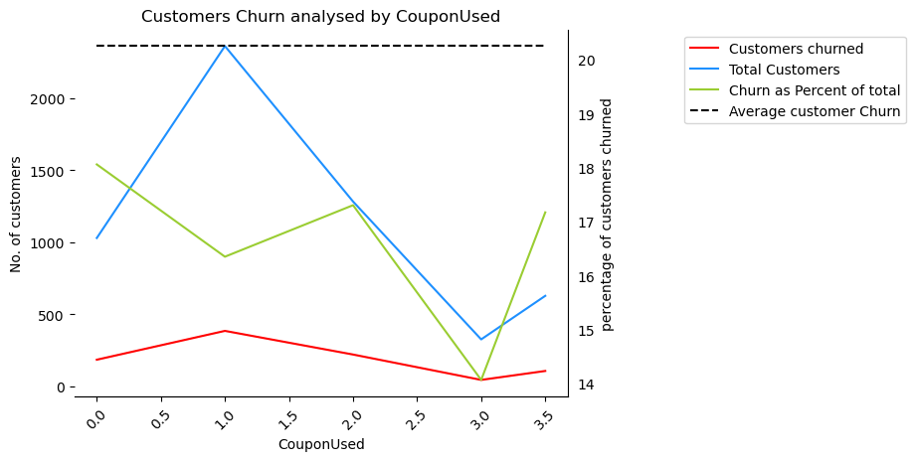
Churn by Coupon Used
Customer who don’t use coupon at all are likely to churn and most customers are use 1-2 coupon. Overall churn percentage is 14-18%.

Slide 15
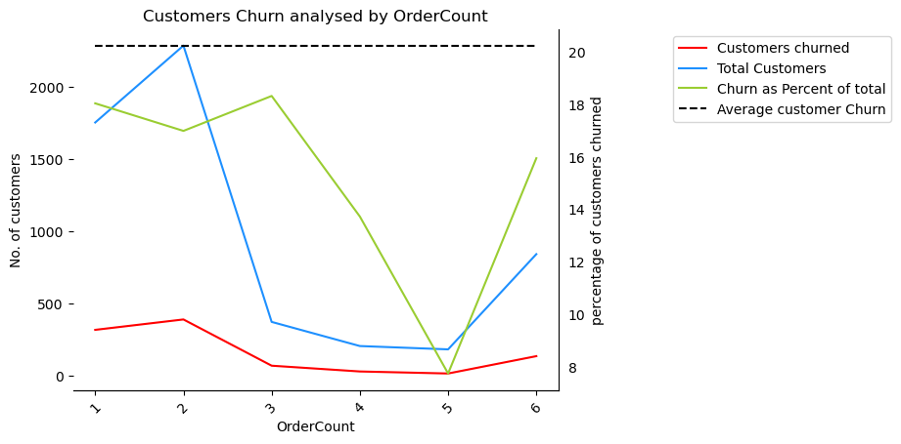
Churn by Order Count
Customer who order more 3 times are less likely to churn which is churn percentage around 7%.

Slide 16
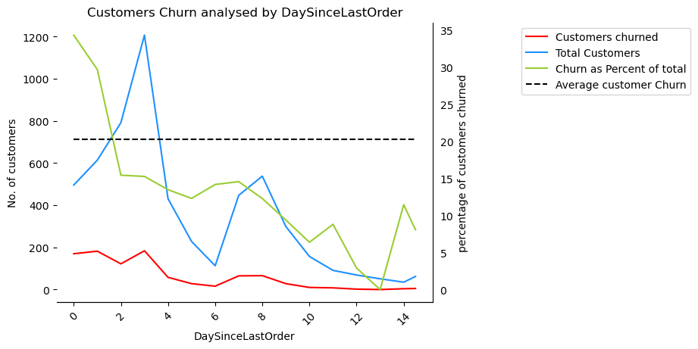
Churn by Day Since Last Order
Customers who has Daysincelastorder from 0-2 days are most likely to churn which is churn percentage is 29-34%.
Most customer their Daysincelastorder is from 2-4 days
Daysincelastorder from 9-13 has churn percentage less than 10%.

Slide 17
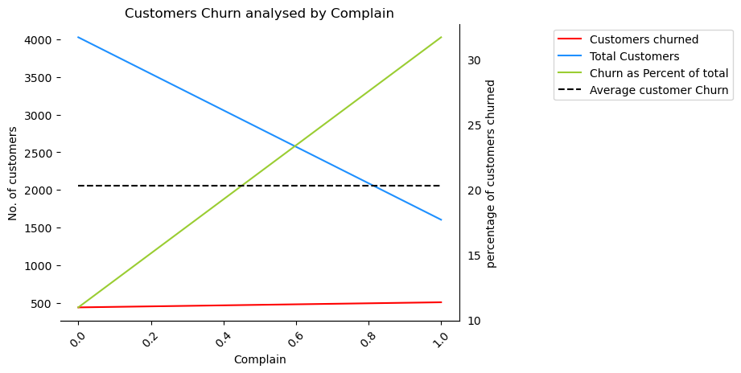
Churn by Complain
Customers who complain the most are likely to churn which 0 complain is 10% and 1 complain is around 31% of churn percentage

Slide 18
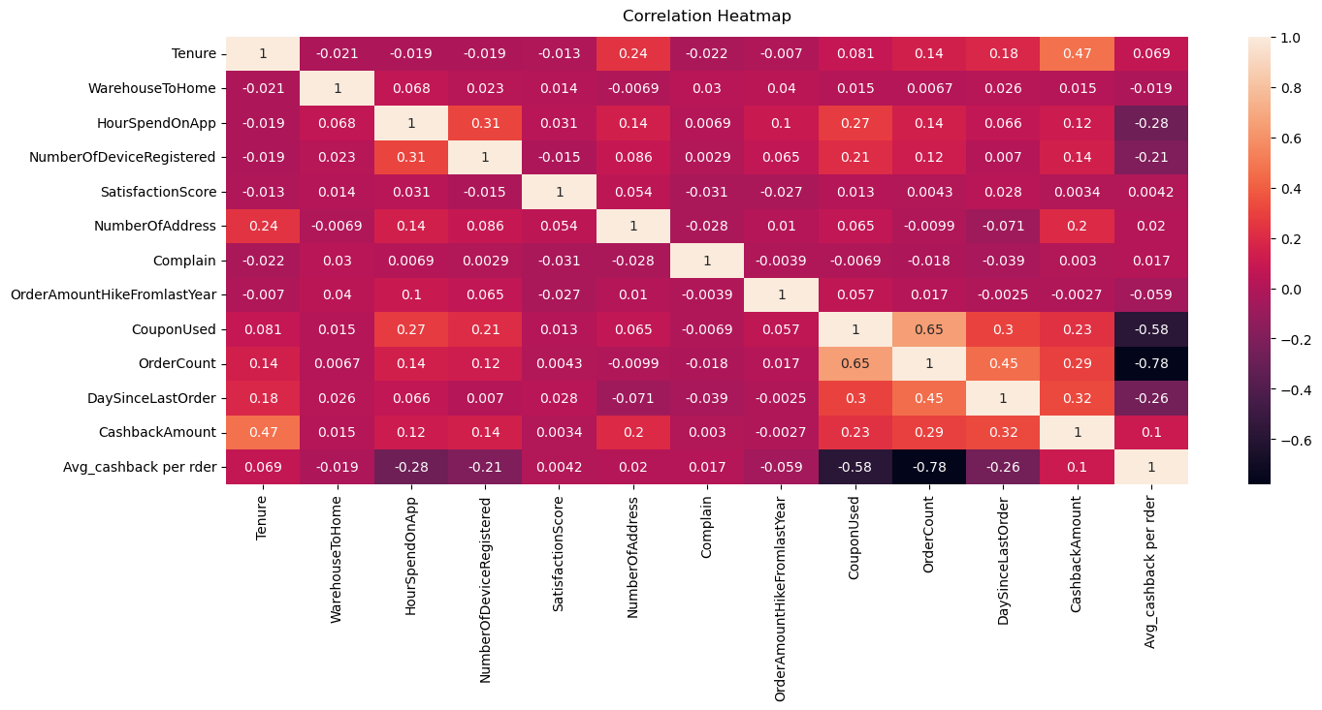
EDA - Bivariate Analysis
CouponUsed and OrderCount are interestingly strongly correlated, making sense as any user with more coupons can place more orders.

Slide 19
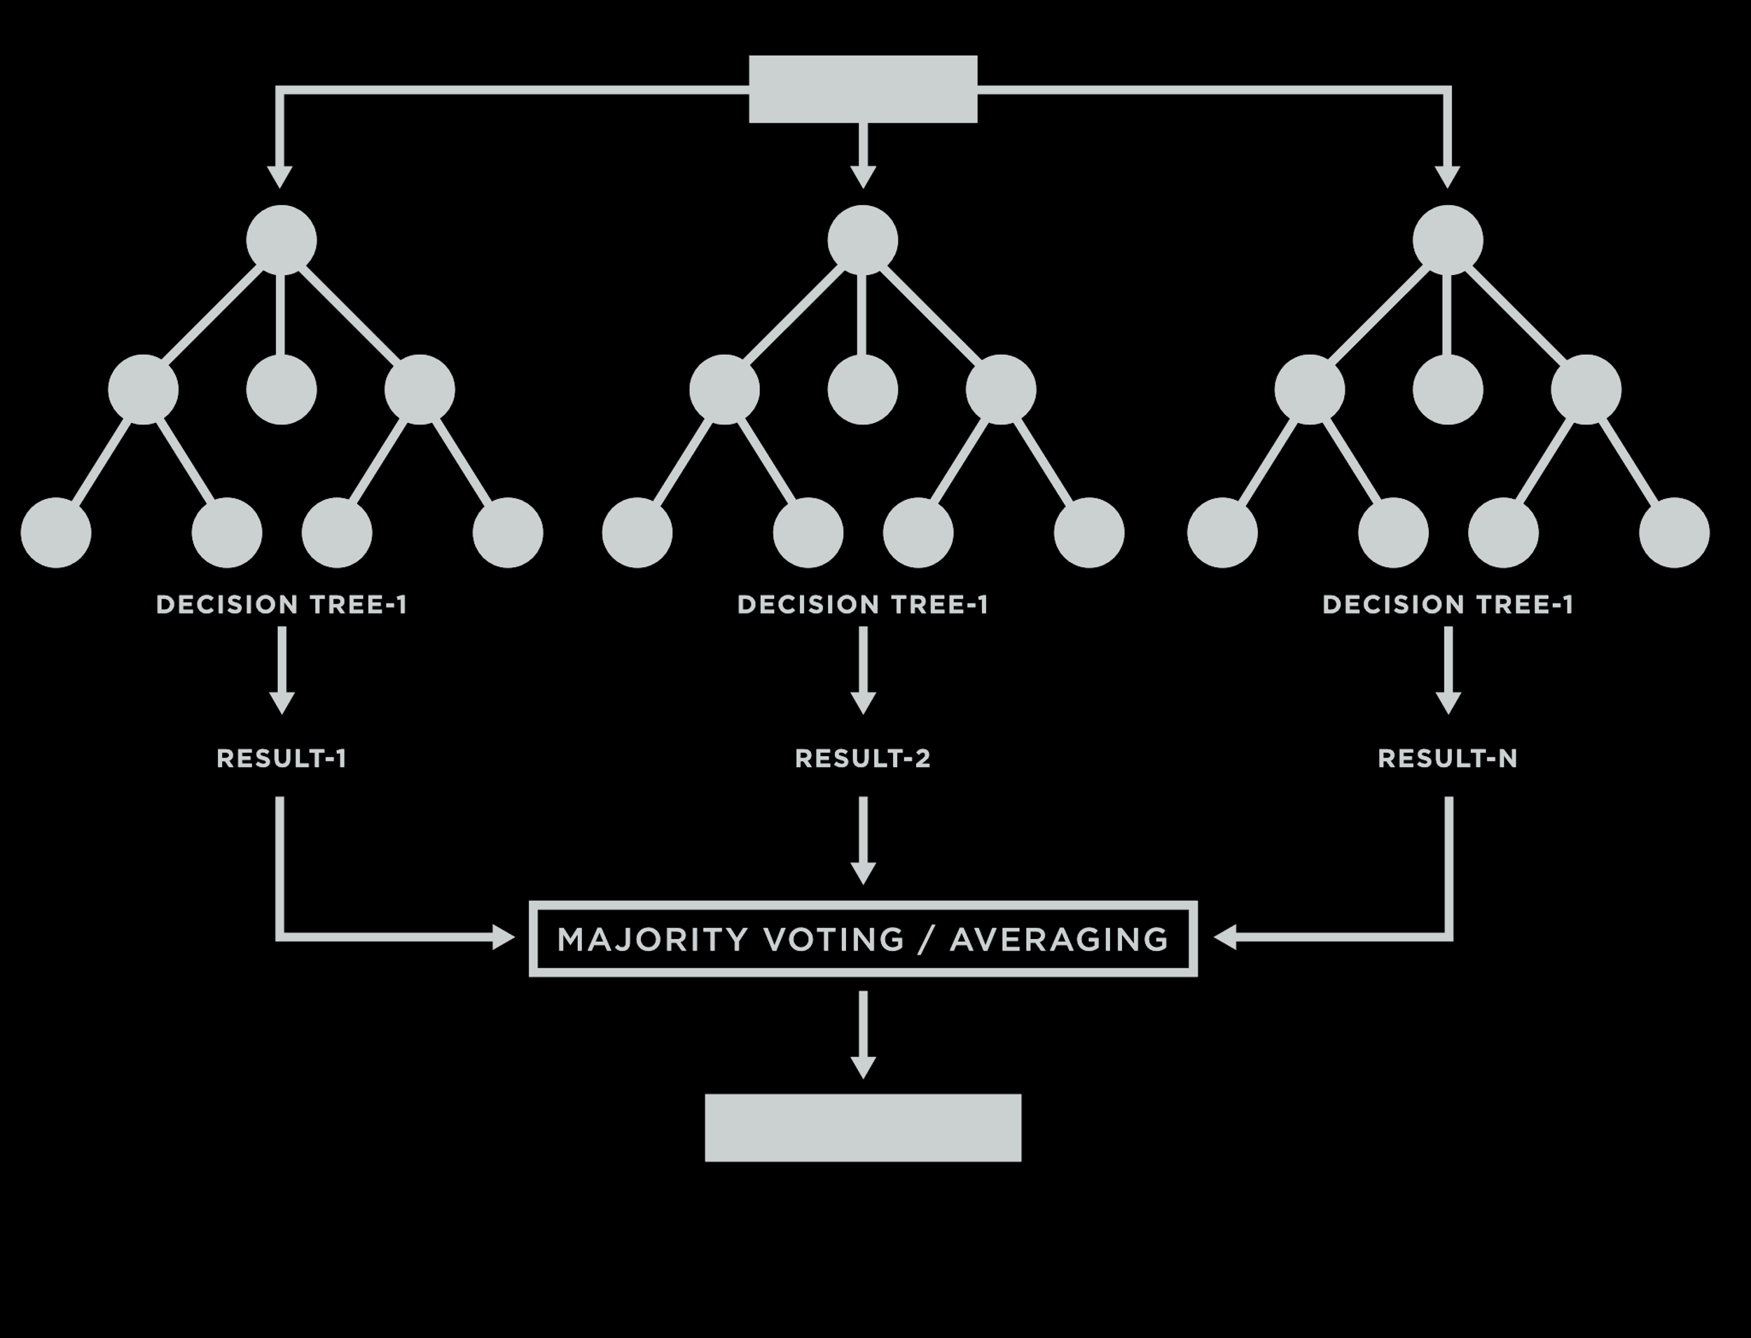
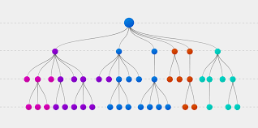
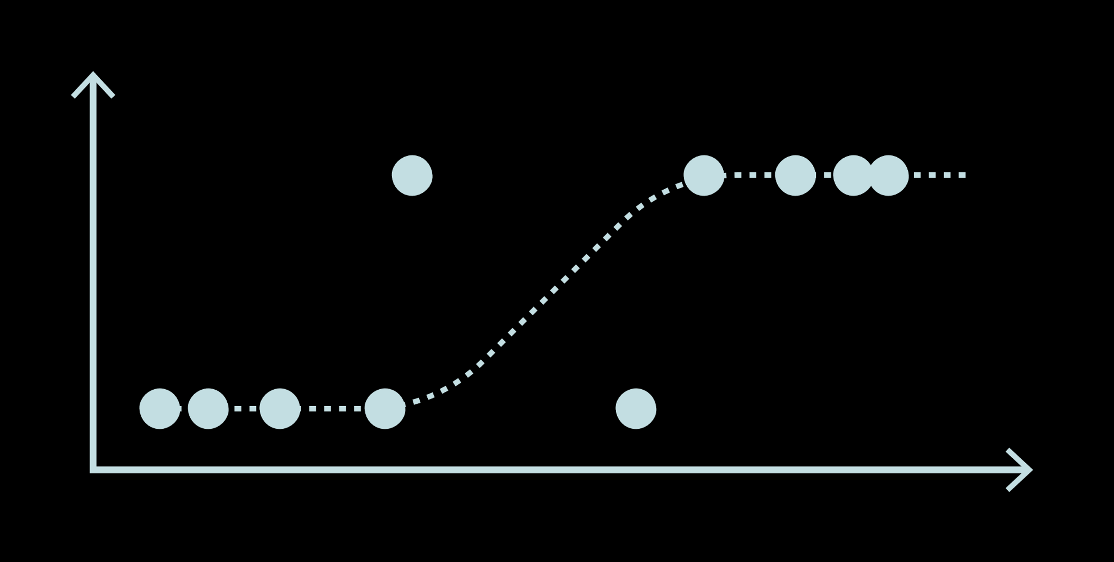
5. Model Building
The cleaned data was split into:
Train dataset: 80%
Test dataset: 20%
The model built are:
Random Forest
Decision Trees
Logistics Regression

Slide 20
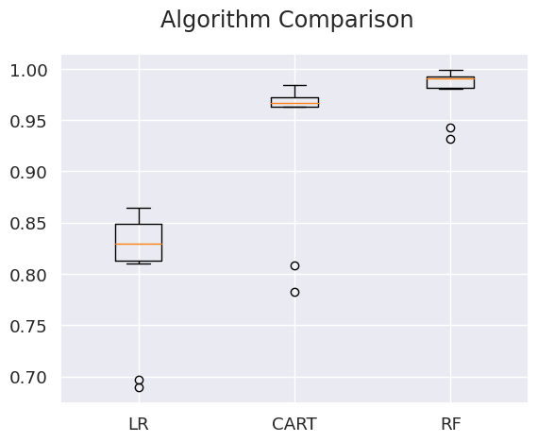
6. Model Evaluation
Model Accuracy comparison
LR: Logistics Regression
CART: Decision Tree
RF: Random Forest

Slide 21
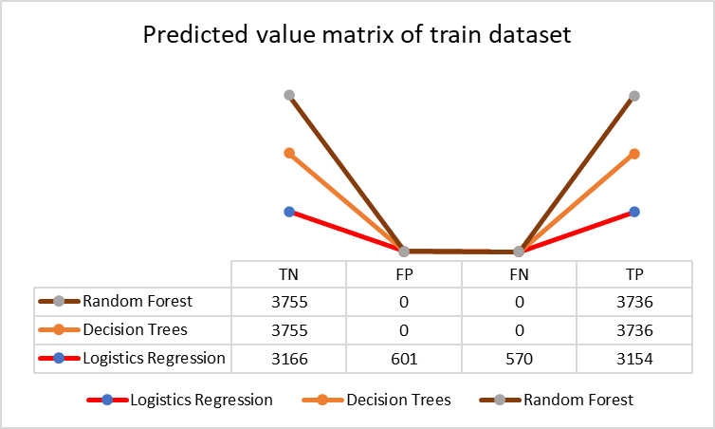
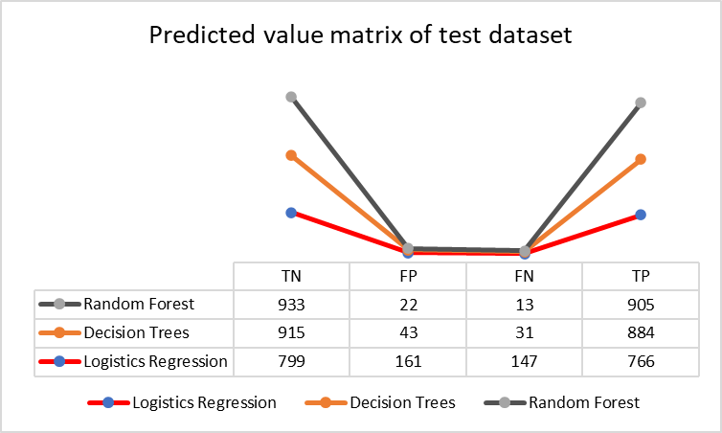
Confusion matrix
The matrix compares the actual target values with those predicted by the machine learning model
TN: True Negative
TP: True Positive
FP: False Positive
FN: False Negative
TN: True Negative
TP: True Positive
FP: False Positive
FN: False Negative

Slide 22
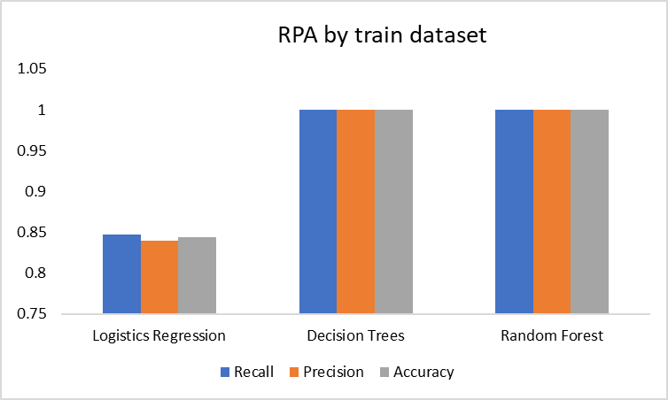
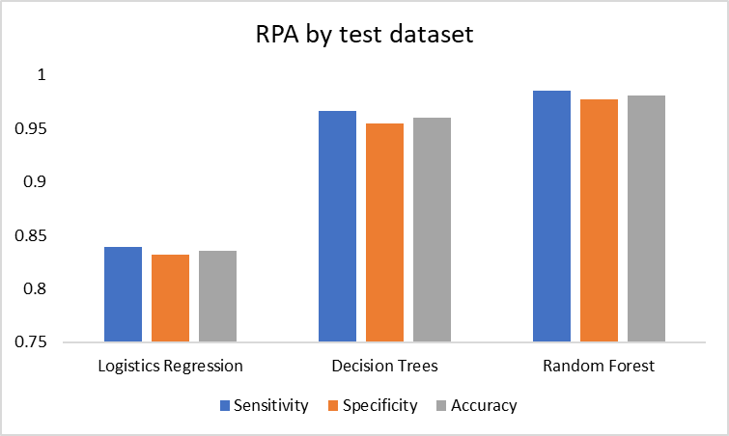
Recall, Precision, and Accuracy
Comparison of each model by Recall , Precision and Accuracy between train and test score

Slide 23
Conclusion
Random Forest
Decision Trees
Random Forest
Logistics Regression
Mean accuracy: 0.979397
Standard deviation accuracy:0.021906
Mean accuracy: 0.935411
Standard deviation accuracy:0.070653
Mean accuracy: 0.809079
Standard deviation accuracy:0.059993

Slide 24
Recommendation
Decision Tree
Logistics Regression
Random Forest
Random forest
For accurate results, the best decision is to go with the Random Forest Classifier.
In this case, the Random Forest Classifier is used to train the model. With the help of the built-in library, the estimators are set to be 100. When the model is run, the result is 97% accurate

Slide 25
Thanks for Attentions

